Slide 1
Special effects in the cinema
The future of the movie industry

Slide 2
« Special effects »
Make-up
Mechanical
Chemical
Computerized

Slide 3

Make-up
Wounds
Masks
Blood
Etc.
Game of Thrones – White walker

Slide 4
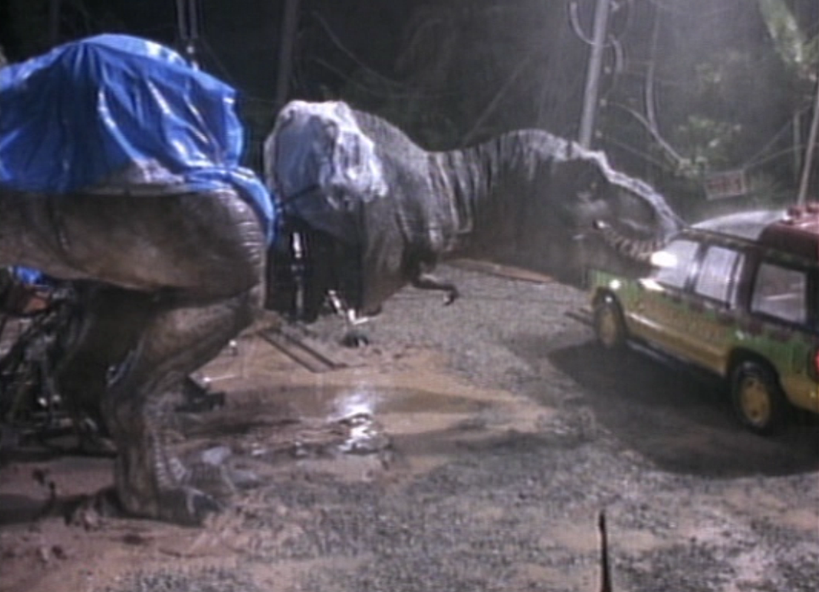
Mechanical
Animatronique
Animated objects
Jurassic Park - Tyrannosaurus rex

Slide 5
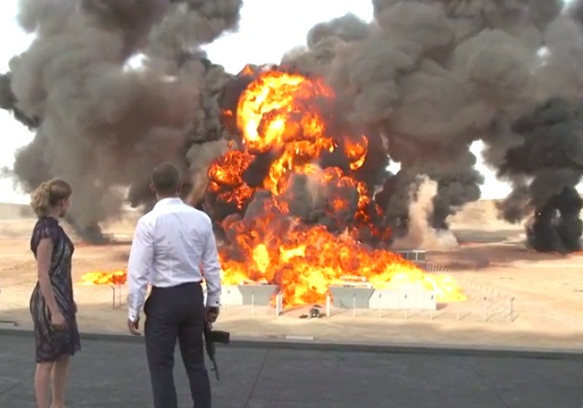
Chemical
Fire
Mist
Explosions
Etc.
James Bond (Spectre) - Explosion

Slide 6
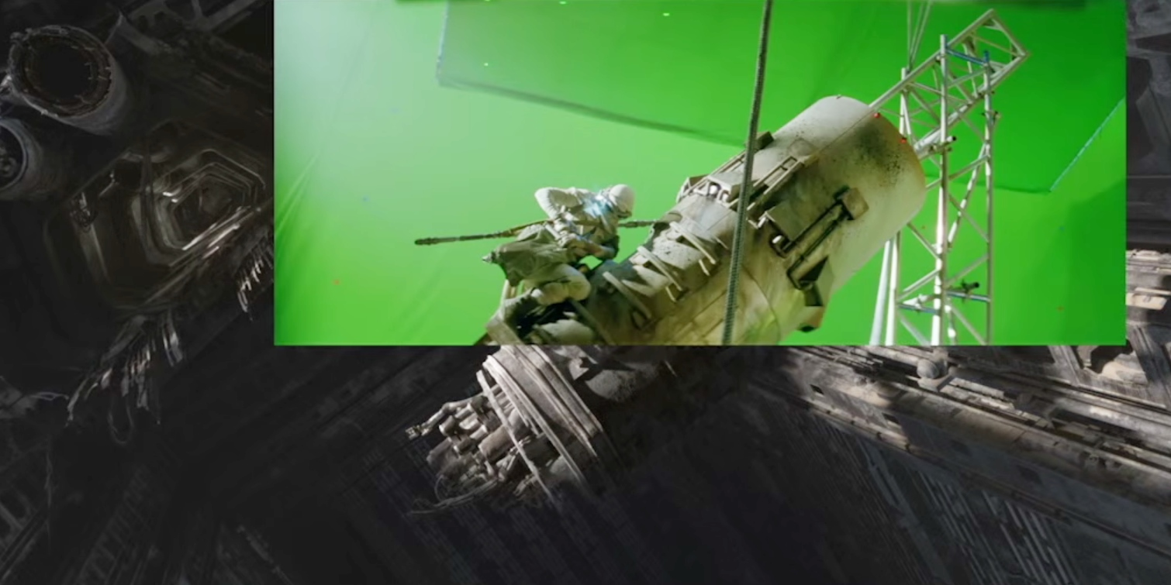
Computerized
CGI (computer generated imagery)
Star Wars : The force awakens

Slide 7
« Future of the cinema »

Slide 8
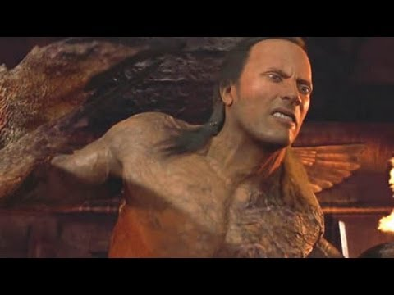
The mummy – Scorpion king made out of CGI
BAD CGI

Slide 9
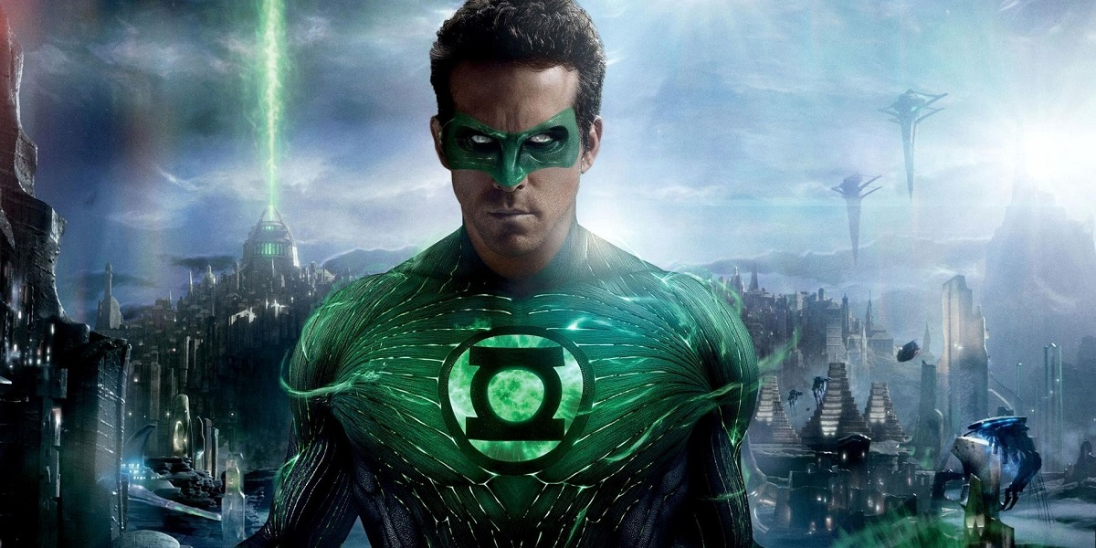
The move to HD and 4K make CGI less convincing
CGI looks realistic in SD
You can see the CGI in HD
Notes:
CGI is far from perfect. But when the delivery format was celluloid and SD, it masked the imperfections of CGI and made everything look more realistic. Filmmakers furthered the illusion by purposely compositing CGI into poorly lit scenes and behind elements like smoke and rain. Now with the stunning clarity of 2K and 4K (and even more so with HFR), we’re starting to see the cracks in the pavement. As resolution increases, CGI is becoming less convincing.

Slide 10
CGI, CGI, CGI and CGI
CGI is (not) the answer
No restraints
CGI encourages lazy filmmaking

Slide 11
Conclusion
CGI is used everywhere, and will be used over and over.
Special effects are just a way to make the movie more immersive.

